Slide 1



Inteligencia de Cliente, Crédito
y Mercado
PRICING STRATEGY

Slide 2

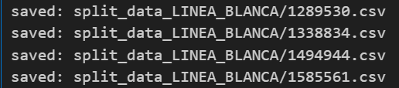

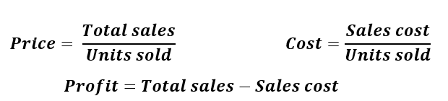
DATA PROCESSING
Dropping
Inv cto, Inv pzas, Precio SAP
Renaming
Splitting
Saving each product as a CSV file named after the product ID
Deleting
files with less than 130 rows, 87 product left
Add Price, Profit and Cost
Not enough data
This is for LINEA BLANCA
Deleting
Nan, negative values of Total sales and Units sold

Slide 3
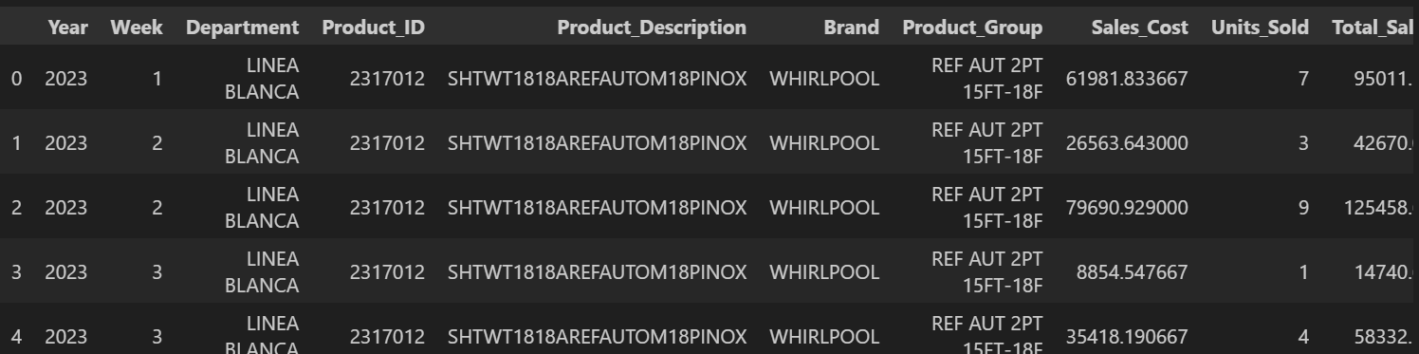
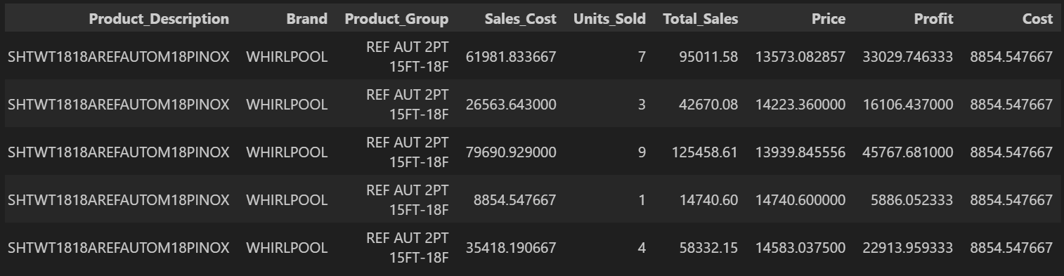

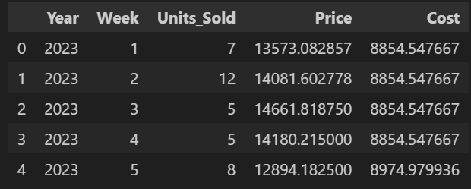
DATA PROCESSING
Unifying
(year,week)

Slide 4

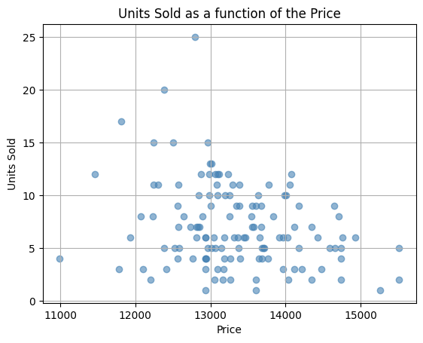
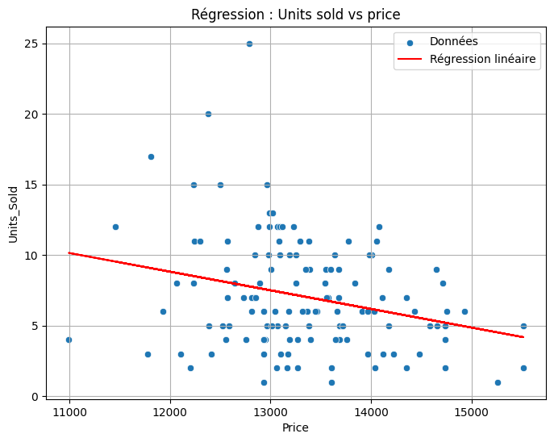
LINEAR REGRESSION
Plotting Units Sold as a function of the Price for a product
Applying Linear Regression

Slide 5
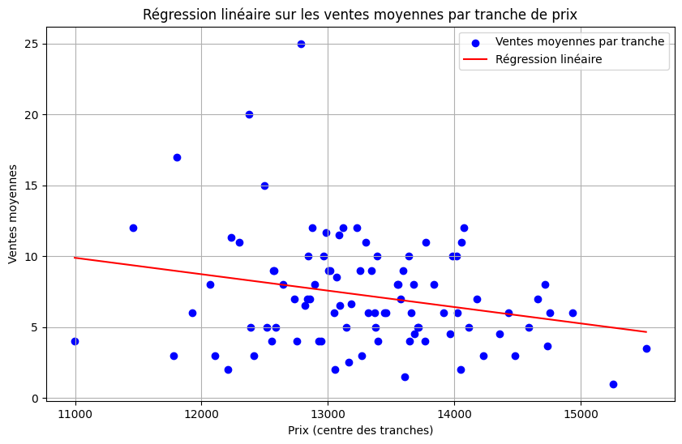


LINEAR REGRESSION
For a small range of prices, we look for one value of the Units Sold
Creating price ranges (bins)
Assigning each product’s price to a bin.
Calculating the average units sold for each price range.
For one price, there are several values of the Units Sold

Slide 6

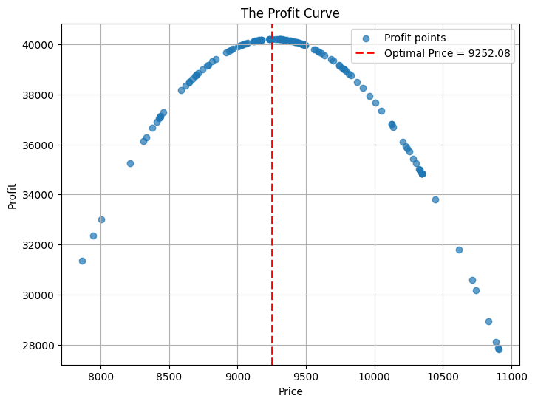
THE PROFIT CURVE AND THE OPTIMAL PRICE

Slide 7
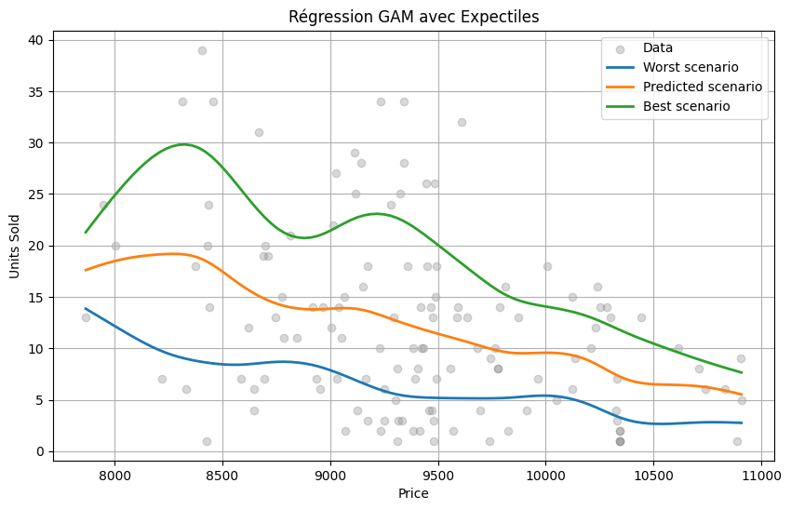
GAM
GENERALIZED ADDITIVE MODEL

Slide 8
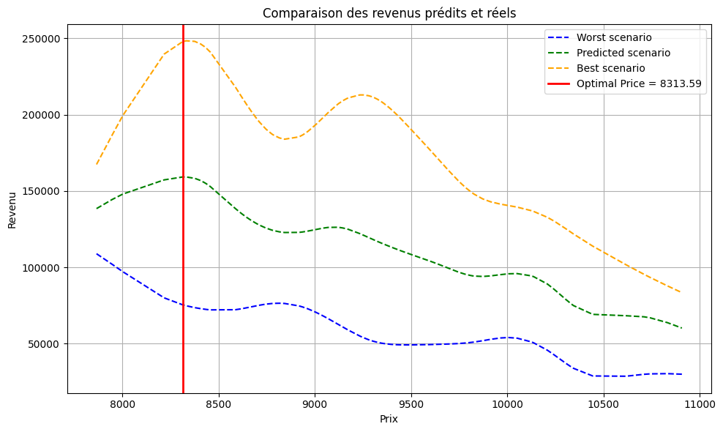
GAM
GENERALIZED ADDITIVE MODEL

Slide 9
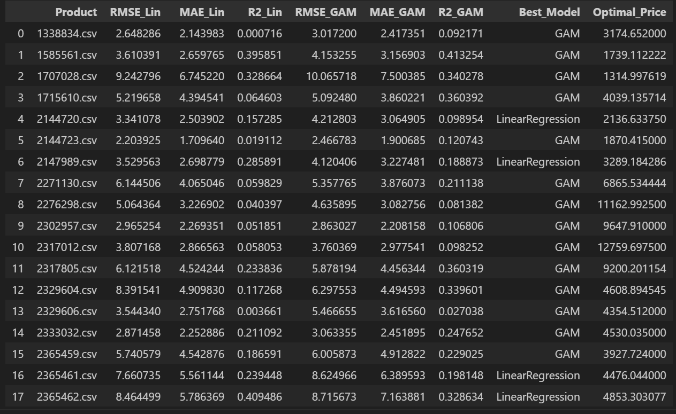
COMPARISON OF LINEAR REGRESSION AND GAM
Out of 87 product, 78 are better predicted by GAM

Slide 10

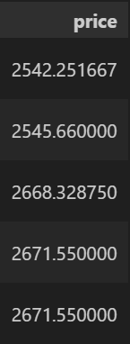
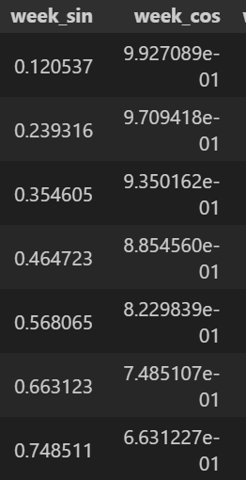
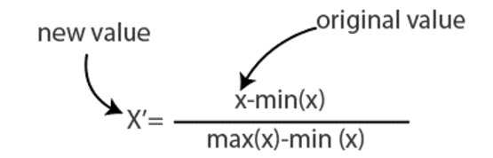
WHAT IF WE TAKE TIME INTO CONSIDERATION ?
Unifying
(year,week)
Seasonality encoding
Variables considered:
Price
Time
normalizing the price
week_sin
week_cos
values between -1 and 1

Slide 11

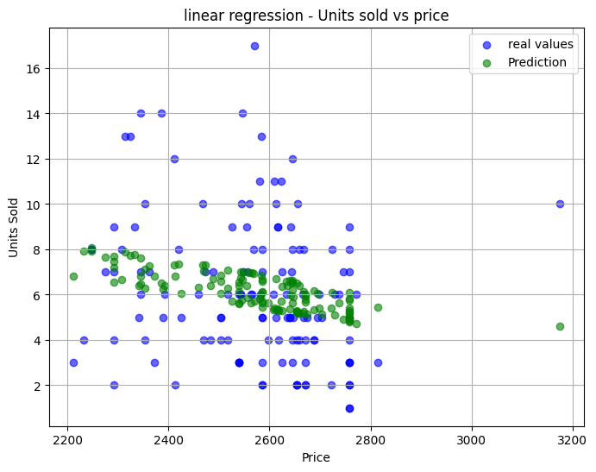
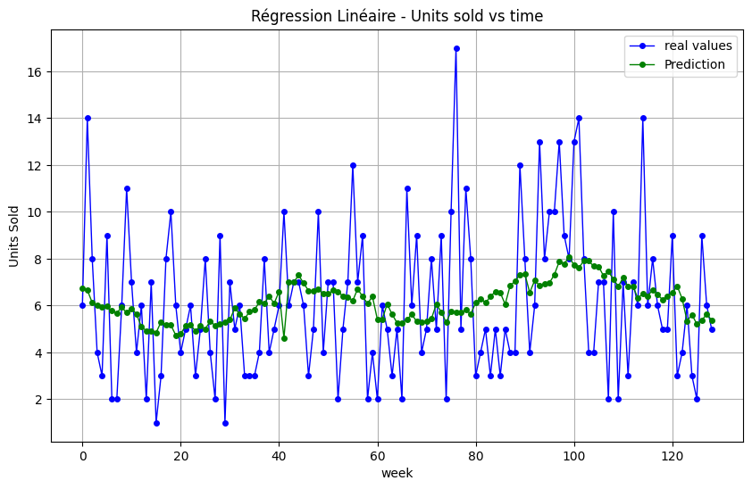
MULTI LINEAR REGRESSION
x1​,x2​ = independent variables, one for the price and one for the time

Slide 12
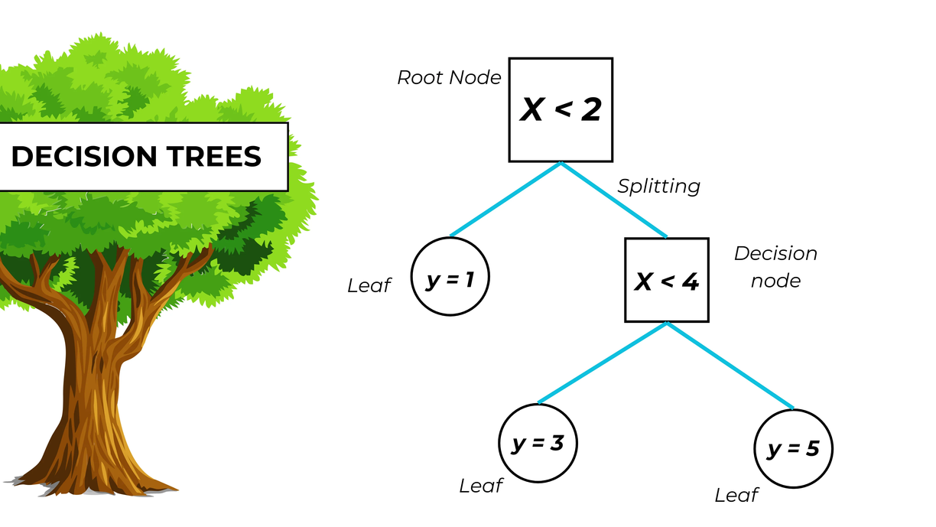
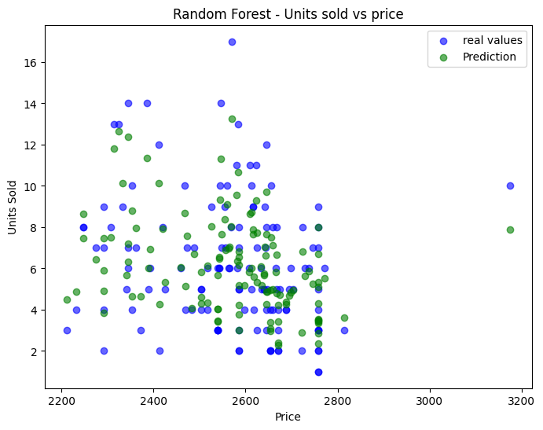
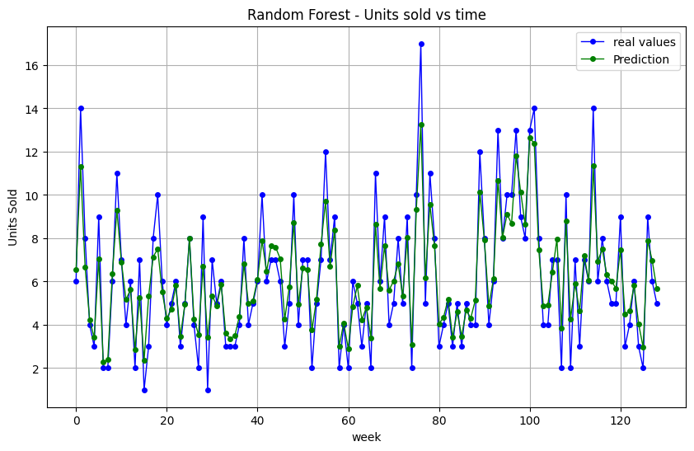
RANDOM FOREST
An ensemble of decision trees that makes predictions by averaging the outputs of many trees

Slide 13
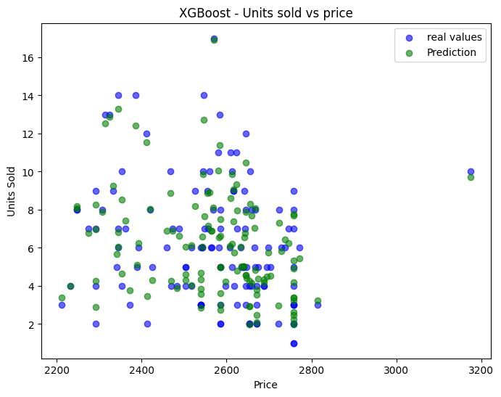
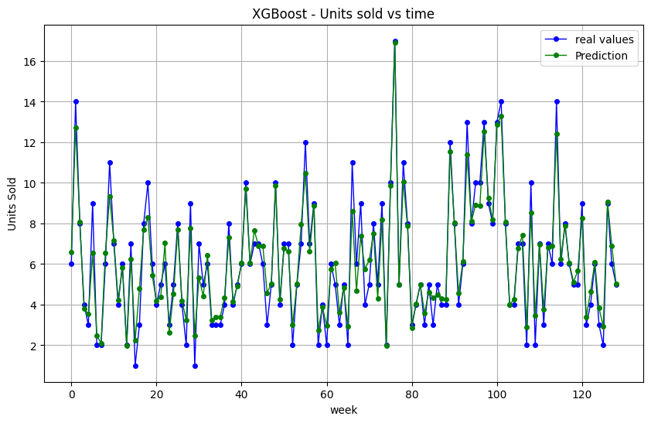
XGBOOST
A boosting algorithm that builds an ensemble of trees sequentially, where each tree corrects the errors of the previous ones.

Slide 14
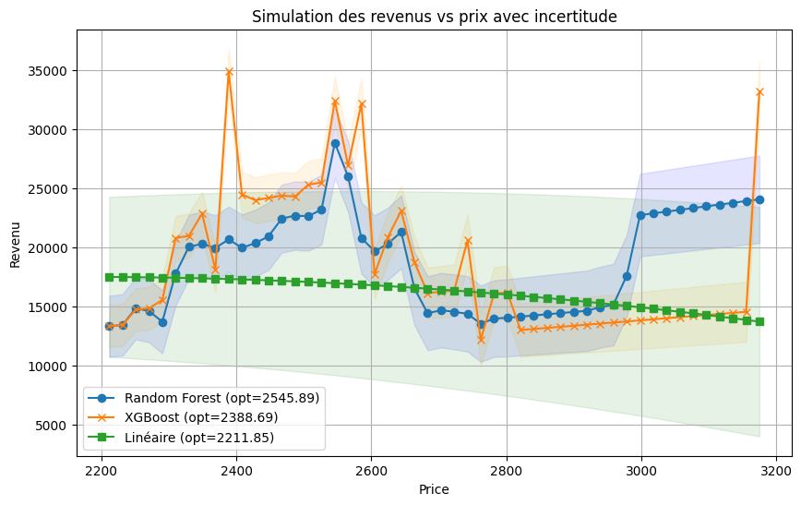
COMPARISON OF THE THREE MODELS

Slide 15
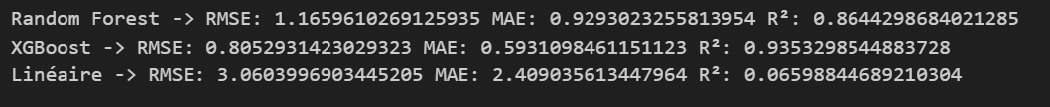
COMPARISON OF THE THREE MODELS
LAST STEP:
APPLYING MODELS TO ALL THE PRODUCTS
This models are useful only if there is a correlation between the Units Sold and the Price

Slide 16
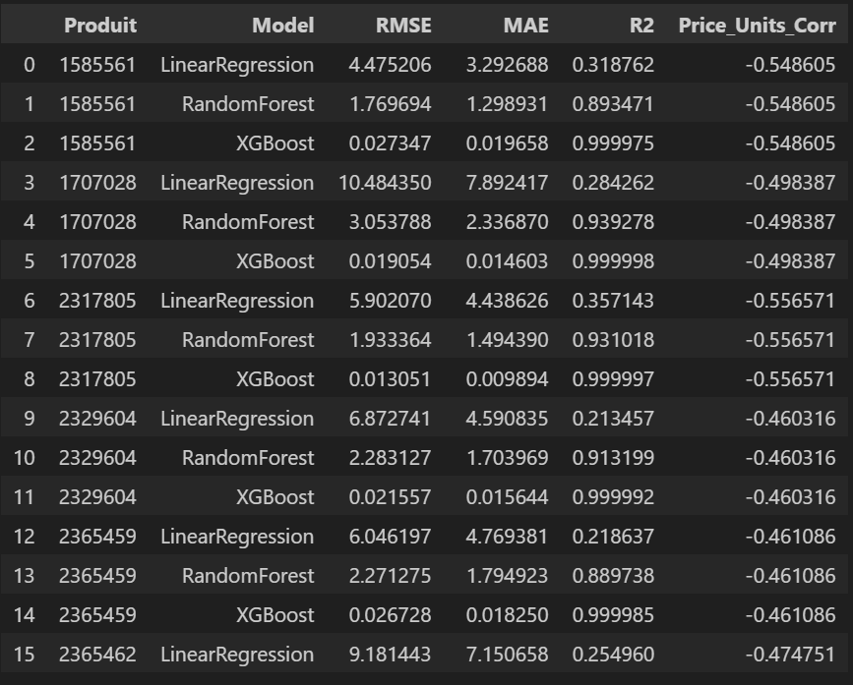
CORRELATION
The correlation between two variables describes how strongly and in what direction they vary together.
Positive correlation: when one increases, the other tends to increase.
Negative correlation: when one increases, the other tends to decrease.
Zero correlation: no linear relationship between them.

Slide 17

THANK YOU

